Slide 1
Employee Data Analysis using Excel
STUDENT NAME: HARINI S
REGISTER NO: 312209984, 9038841E201F82BA4B14BE72723B3B68
DEPARTMENT: B.COM (GENERAL)
COLLEGE: VALLIAMMAL COLLEGE FOR WOMEN

Slide 2
PROJECT TITLE
Employee Performance Analysis using Excel

Slide 3


AGENDA
Problem Statement
Project Overview
End Users
Our Solution and Proposition
Dataset Description
Modelling Approach
Results and Discussion
Conclusion
3/21/2024 Annual Review

Slide 4

PROBLEM STATEMENT
Purpose of this project is to analyse employee data by examining how business unit, gender, employee type to find out the performance level impact within organisation. For the purpose of tracking the performance, then we can able to focus on growth.
Efficiency and productivity, data visualization, scalability and flexibility, cost-effective, security and compliance, analytics and insights, integration and compatibility are analysis with the help of excel.

Slide 5

PROJECT OVERVIEW
.
Employee performance analysis is the analysing the performance of the employee by considering various factors like business unit, gender, performance score, rating, achievements in order to identify the trends and patterns of different types of employee like very high, high, medium, low.

Slide 6




WHO ARE THE END USERS?
EMPLOYER
MANAGER
EMPLOYEES

Slide 7

OUR SOLUTION AND ITS VALUE PROPOSITION
Conditional formatting – missing
Filter – remove values
Formula – performance
Pivot table – summary of employee performance
Bar diagram – data visualization

Slide 8
Dataset Description
Employee ID
First Name
Last Name
Start date
Exit date
Title
Supervisor
AD Email
Business unit
Employees status
Employees type
Pay zone
Job function
Gender code
Performance level

Slide 9

THE "WOW" IN OUR SOLUTION
PERFORMANCE LEVEL =IF(Z8>=5,”VERY HIGH”,IF(Z8>=4,”HIGH”,IF(Z8>=3,”MED”,IF(Z8<=2,”LOW”))))
3/21/2024 Annual Review
9

Slide 10
MODELLING
STEP 1
DOWNLOAD THE EMPLOYEE DATASET FROM KAGGLE AND OPEN THE EMPLOYEE DATASET IN EXCEL.
STEP 2
SELECT THE ENTIRE DATA AND CLICK ON DATA AND CLICK ON FILTER OPTION.
STEP 3
FILTER FROM ATO Z ORDER.
STEP 4
SELECT THE ENTIRE DATA AND CLICK ON INSERT AND CLICK O PIVOT TABLE TO CREATE PIVOT TABLE.
STEP 5
DRAG THE NEEDED DATA AND CREATE A PIVOT TABLE.
STEP 6
SELECT THE PIVOT TABLE AND CLICK ON INSERT.
STEP 7
NOW CLICK ON THE RECOMMENDED CHART.
STEP 8
THE CHART IS CREATED AND FIX CHART TITLE, AXIS TITLE, TRENDLINE.
10

Slide 11
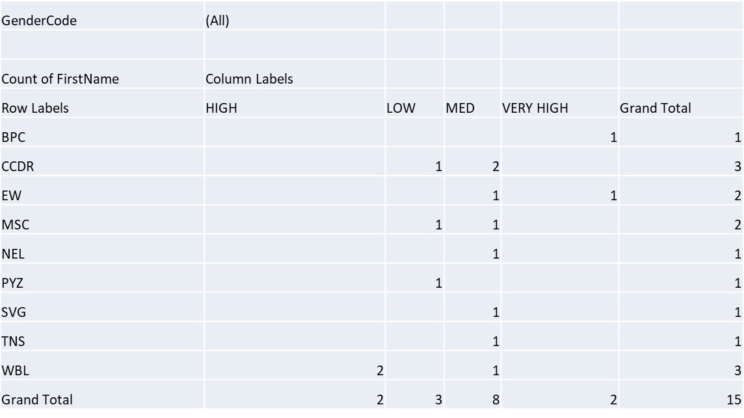
RESULTS
PIVOT TABLE
11

Slide 12
PIVOT CHART

Slide 13
conclusion
Overall, the performance review highlights the strengths and areas for improvement for each employee. High performers demonstrate
Exceptional skills, dedication, and alignment with company goals, contributing significantly to team success.
Areas identified for development include enhancing specific skills, addressing performance gaps, and leveraging additional training opportunities.

